Slide 1
Doing Business 2019
Registering Property
Brazil Improvements
March 29, 2018

Slide 2
Registering Property
Questionnaire
Procedure | Description
Procedure 1 | Certificates of Registries and Disputes
Comments:
This procedure should be excluded because this certificate it is not required by law.
The buyer also can check the existence of debts on line, at no cost: www.protesto.com.br
If the free research results in no debts, the certificate shall not be necessary.
Even when the buyer prefers to request this certificate, notary will be responsible for providing it simultaneously with procedure 12 - Drafting of Public Deed of Purchase and Sale.

Slide 3
Registering Property
Questionnaire
Procedure | Description
Procedure 2 | Certificate of Civil Distributor, Fiscal Executive, Bankruptcy from the City Court Office
Comments:
This procedure should be excluded since this certificate was waived by Law 13.097 / 2015 and also by NOTICE No. 276/2015 from General Court of Justice of the State of São Paulo.
Law 13.097 dated January 19, 2015, which became effective on February 19, 2017, amended the article 1, § 2 of Law 7.433/85 and ELIMINATED the requirement for these certificates.
Even when buyer prefers to request this certificate, notary will be responsible for providing it simultaneously with procedure 12 - Drafting of Public Deed of Purchase and Sale.
The certificate is issued on line, at no cost. Time to complete: less than a day.

Slide 4
Registering Property
Questionnaire
Procedure | Description
Procedure 3 | Labor Justice Certificate from the Regional Labor Court
Comments:
This certificate should be excluded because it is not required by law.
Even when buyer prefers to request this certificate, notary will be responsible for providing it simultaneously with procedure 12 - Drafting of Public Deed of Purchase and Sale.

Slide 5
Registering Property
Questionnaire
Procedure | Description
Procedure 4 | Certificate of Good Standing on Labor debts (CNDT)
Comments:
This certificate is issued on line, at no cost, and notary is responsible for providing it simultaneously with procedure 12 - Drafting of Public Deed of Purchase and Sale.

Slide 6
Registering Property
Questionnaire
Procedure | Description
Procedure 5 | 20-year Certificate (Real Estate Property Registry)
Comments:
This certificate is mandatory, can be obtained on line and is also requested by the notary simultaneously with procedure 12 - Drafting of Public Deed of Purchase and Sale.

Slide 7
Registering Property
Questionnaire
Procedure | Description
Procedure 6 | Land tax and Cadastral Certificates (City Hall)
Comments:
The buyer can waive this certificate if he assumes the obligation to pay all the landing tax debts related to the real estate (art. 1, paragraph 2, Decree 93.240/86)
Even when the buyer prefers to request this certificate, notary will be responsible for providing it simultaneously with procedure 12 - Drafting of Public Deed of Purchase and Sale.

Slide 8
Registering Property
Questionnaire
Procedure | Description
Procedure 7 | Clearance Certificate from Tax Agency and a Federal Tax Clearance Certificate
Comments:
This certificate should be excluded because notary can provide it simultaneously with procedure 12 - Drafting of Public Deed of Purchase and Sale.
It is no longer necessary to obtain two certificates according to Portaria RFB / PGFN nº 1.751 dated October 2, 2014. It unified both certificates, covering all the federal tax credits administered by the RFB – Receita Federal and PGFN.
Besides that, notaries can waive these certificates according to item 59.2, Chapter XIV of NSCGJSP (Sao Paulo State General Court of Justice).

Slide 9
Registering Property
Questionnaire
Procedure | Description
Procedure 8 | Worker’s Fund Certificate at the federal bank Caixa Econômica Federal
Comments:
This certificate should be excluded because it has never been required by law.
Even if buyer prefers to request this certificate, notary will be responsible for providing it simultaneously with procedure 12 - Drafting of Public Deed of Purchase and Sale.

Slide 10
Registering Property
Questionnaire
Procedure | Description
Procedure 9 | Federal Justice Certificate
Comments:
Law 13.097 dated January 19, 2015, which became effective on February 19, 2017, amended the article 1, § 2 of Law 7.433 / 85 and ELIMINATED the requirement for theses certificates to sign public deeds.
In addition, the General Court of Justice of the State of São Paulo also waived the certificates from Civil Distributors according to the announcement NOTICE CG No. 276/2015.
This procedure should be excluded, since this certificate was waived by Law 13.097/2015 and also by NOTICE No. 276/2015 of Sao Paulo State General Court of Justice.

Slide 11
Registering Property
Questionnaire
Procedure | Description
Procedure 10 | Company Name Certificate – Nptary obtains company information
Comments:
This procedure should be excluded because it is already included on procedure 12 and it is done by the notaries when drafting public deeds. It can’t be considered as a singular procedure.

Slide 12
Registering Property
Questionnaire
Procedure | Description
Procedure 11 | Pay transfer tax (ITBI)
Comments:
This procedure should be excluded because it is already included on procedure 12 and it is done by the notaries when drafting public deeds.
It can’t be considered as a singular procedure as it is a part of the notary’s job to fill out the tax forms and to make sure that the transfer tax has been paid.
It can be paid on line by the notary on the internet banking (less than one day).

Slide 13
Registering Property
Questionnaire
Procedure | Description
Procedure 12 | Drafting of Public Deed of Purchase and Sale
Comments:
Most of procedures reported on this questionnaire are part of the notary’s job.
The public deed of Purchase and Sale can be requested on line at: www.escriturasimples.org.br

Slide 14
Registering Property
www.escriturasimples.org.br

Slide 15
Registering Property
www.escriturasimples.org.br
Portal for requesting public transfer property deed online
Requesters (buyers, sellers or their agents) fill out property and parties information, select certificates to be generated and choose a notary to provide all steps of registering property.
Notary provides all the necessary documentation and procedures:
Request all certificates
Draft and Notarize the Public Deed
Provide transfer tax payments
Dispatch for transferring deed registration at the competent Real State Registry
Notary is a single point of contact for requesters

Slide 16
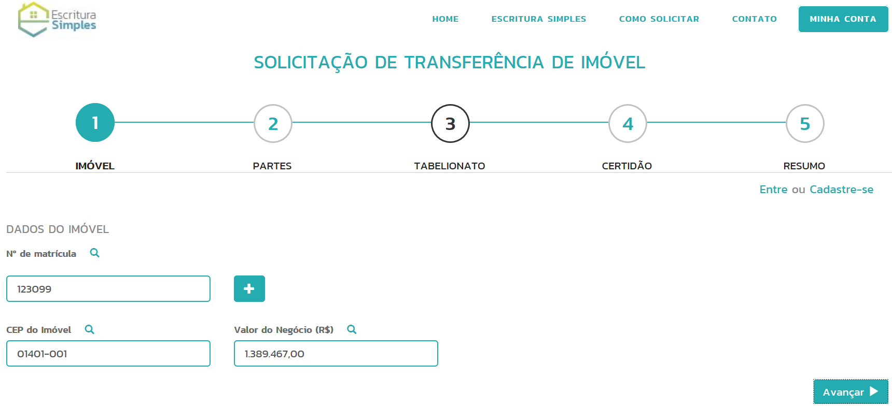
Registering Property
www.escriturasimples.org.br
Public Deed Request
Fill out property data and value

Slide 17
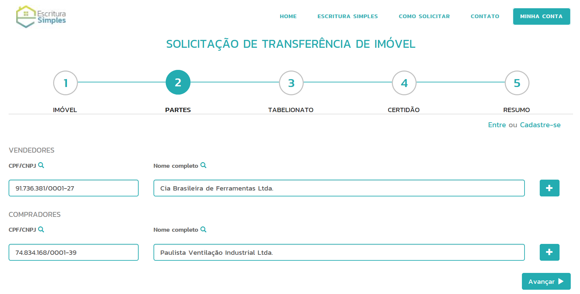
Registering Property
www.escriturasimples.org.br
Public Deed Request
Fill out buyer and seller

Slide 18
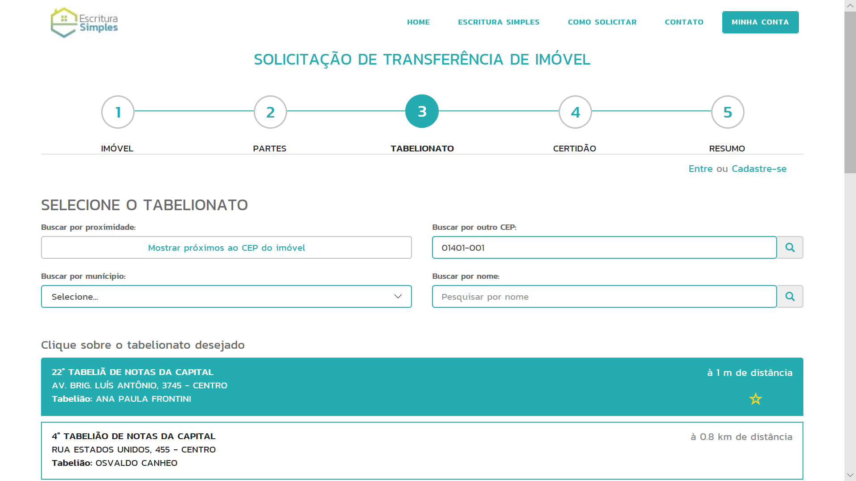
Registering Property
www.escriturasimples.org.br
Public Deed Request
Select Notary’s Office

Slide 19
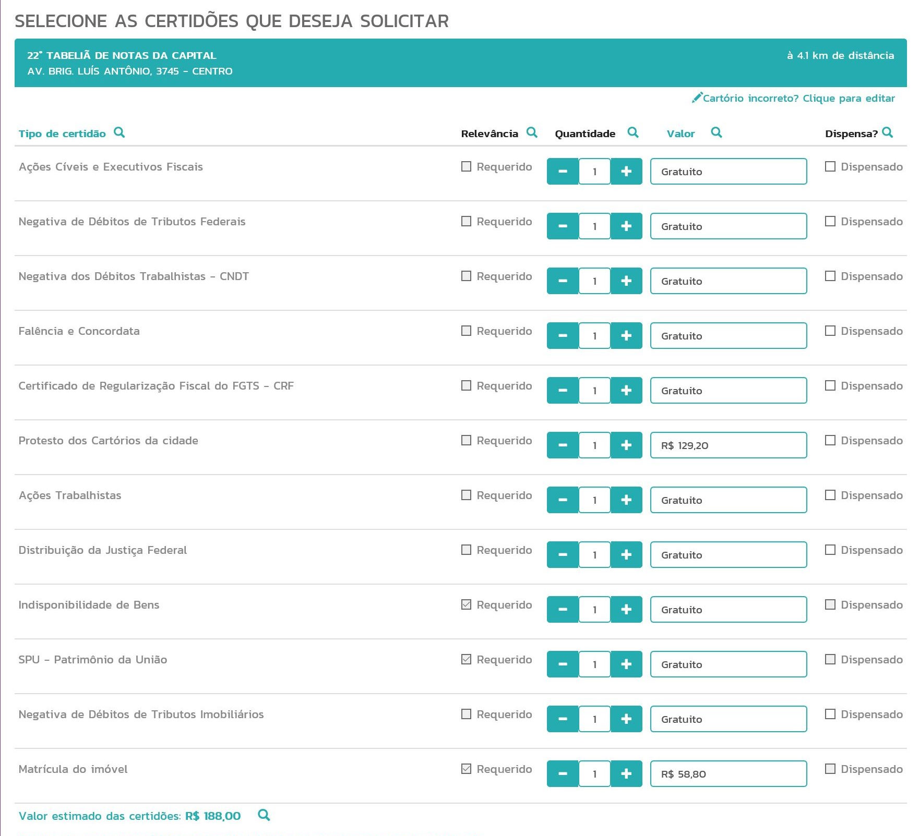
Registering Property
www.escriturasimples.org.br
Public Deed Request
All certificates are listed and requested in just one step

Slide 20
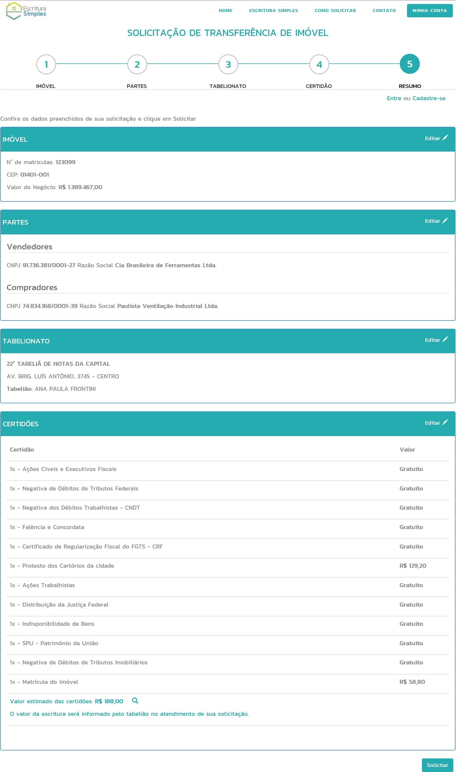
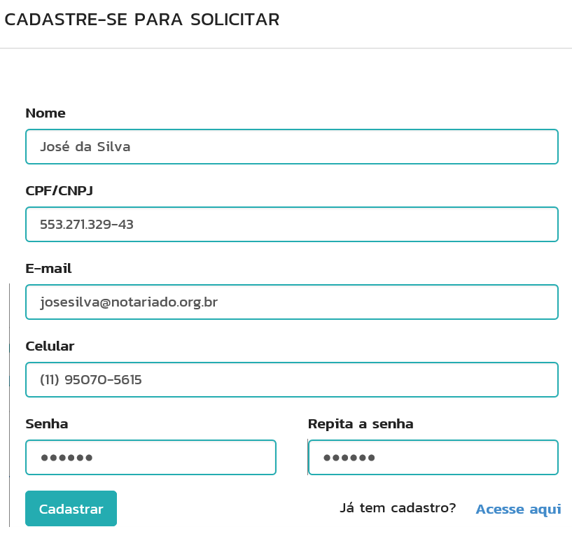
Registering Property
www.escriturasimples.org.br
Public Deed Request
Check out of request
Creating Requester account

Slide 21
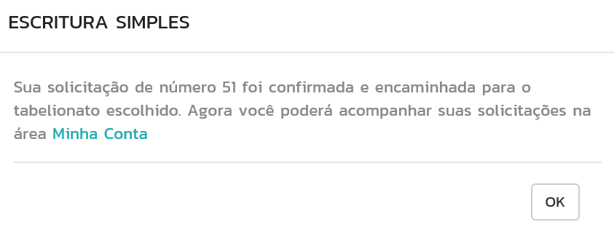
Registering Property
www.escriturasimples.org.br
Request confirmation

Slide 22
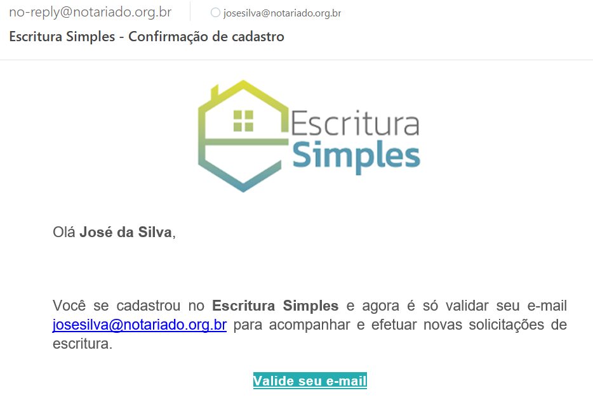
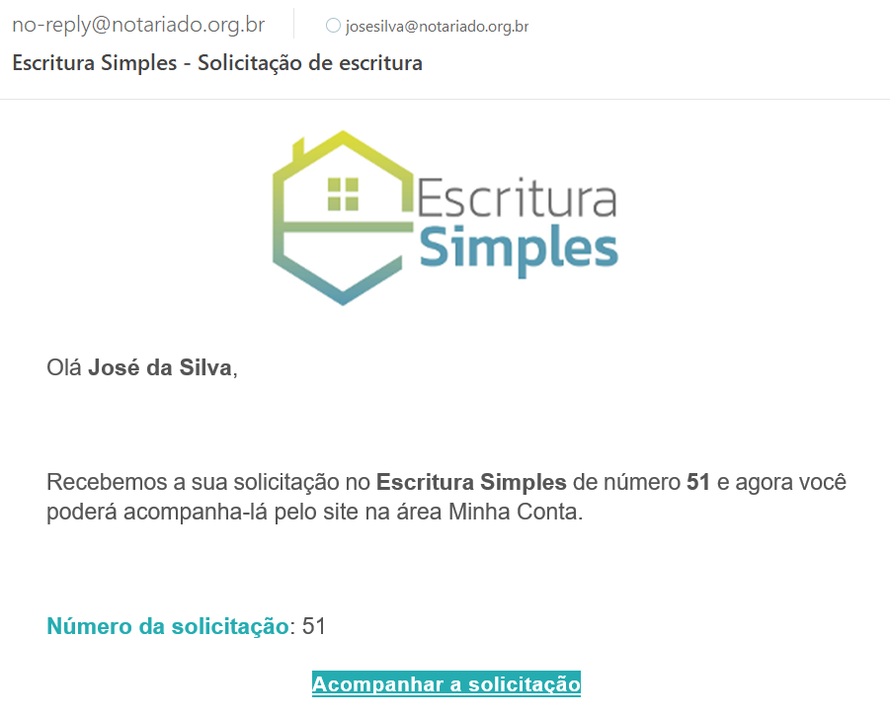
Registering Property
www.escriturasimples.org.br
E-mail to validate requester account
E-mail to inform request number

Slide 23
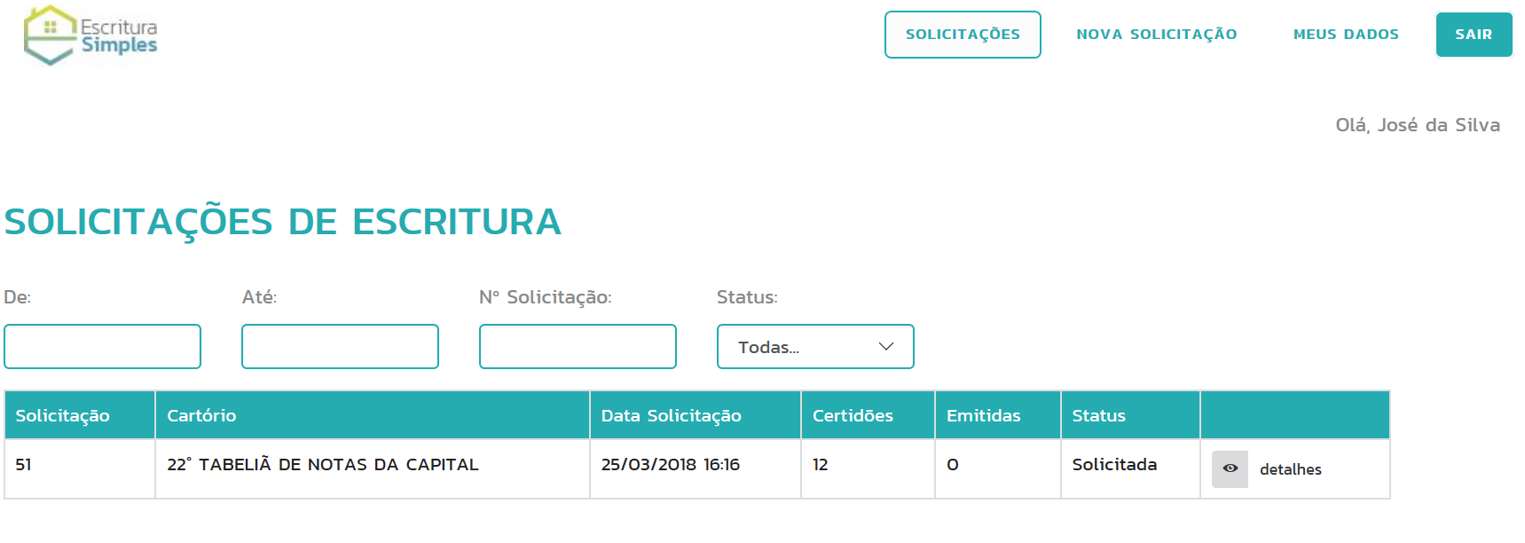
Registering Property
www.escriturasimples.org.br
Requester’s follow up

Slide 24
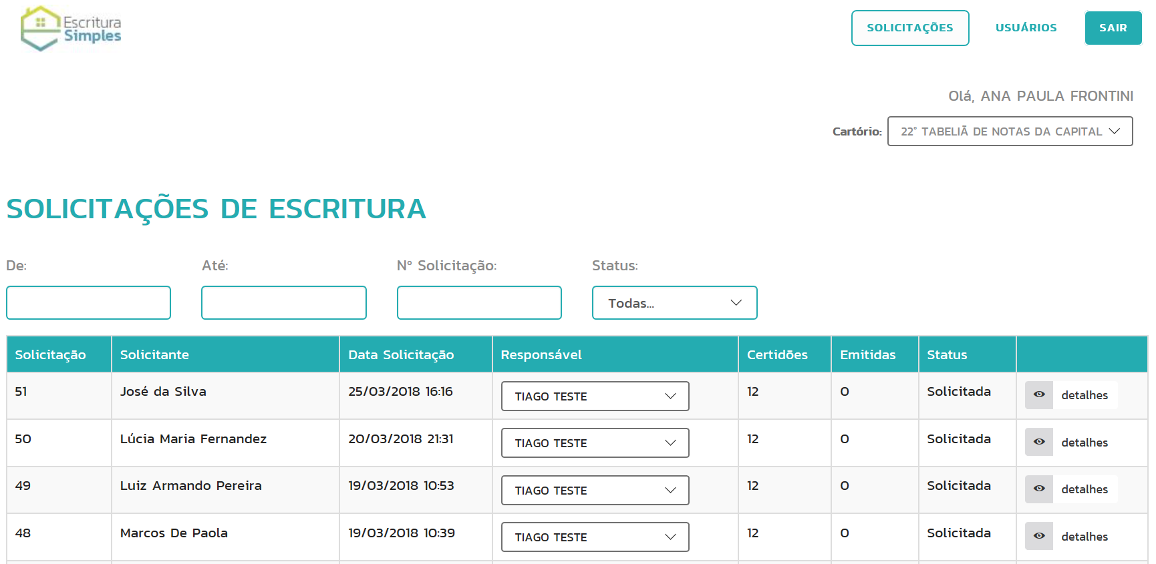
Registering Property
www.escriturasimples.org.br
Notary Office follow up

Slide 25
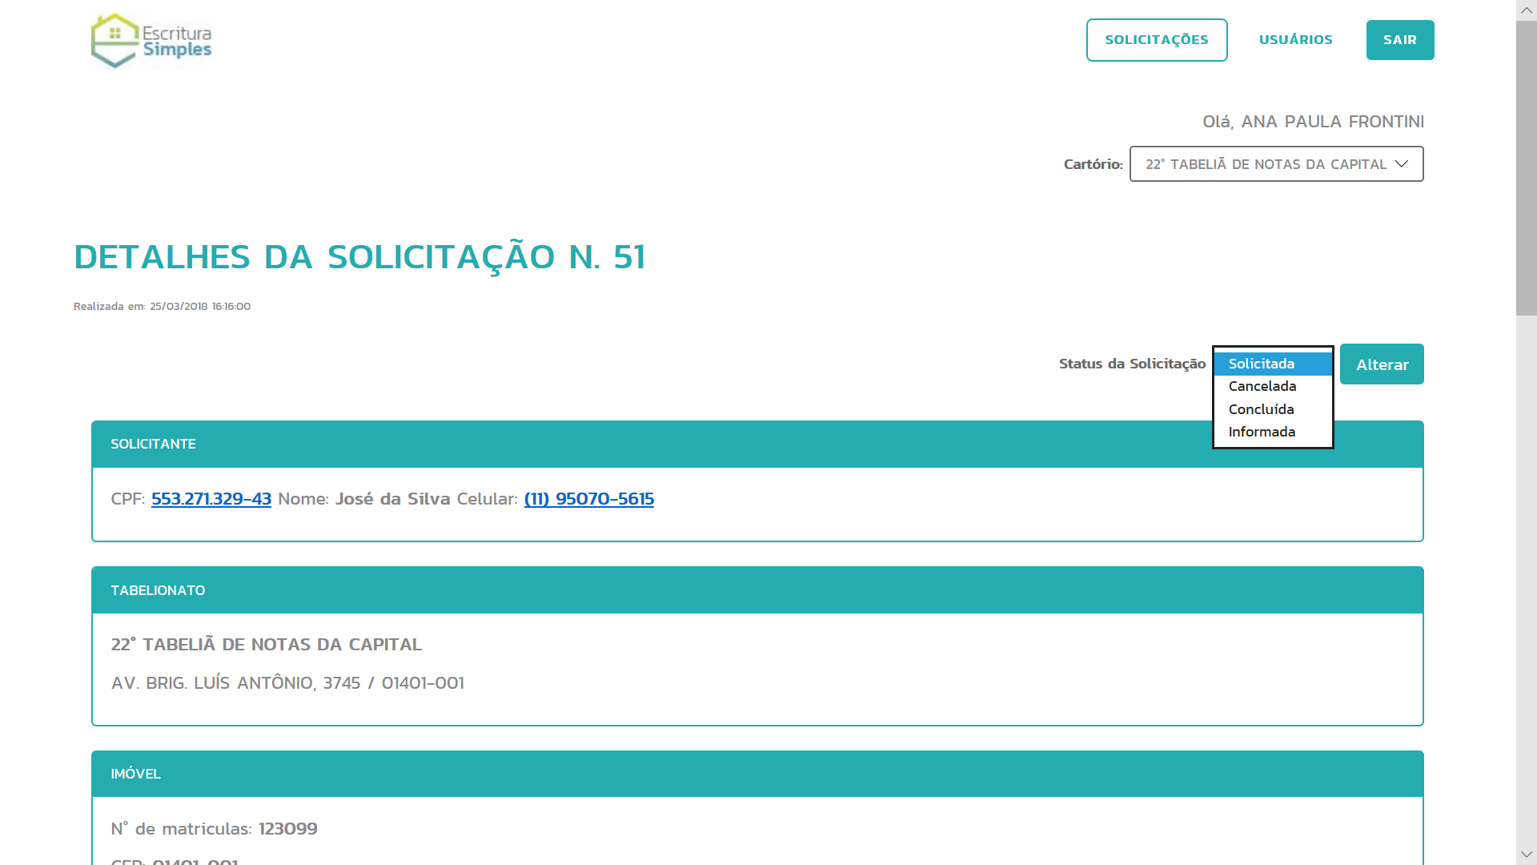
Registering Property
www.escriturasimples.org.br
Update of Request by Notary Office

Slide 26
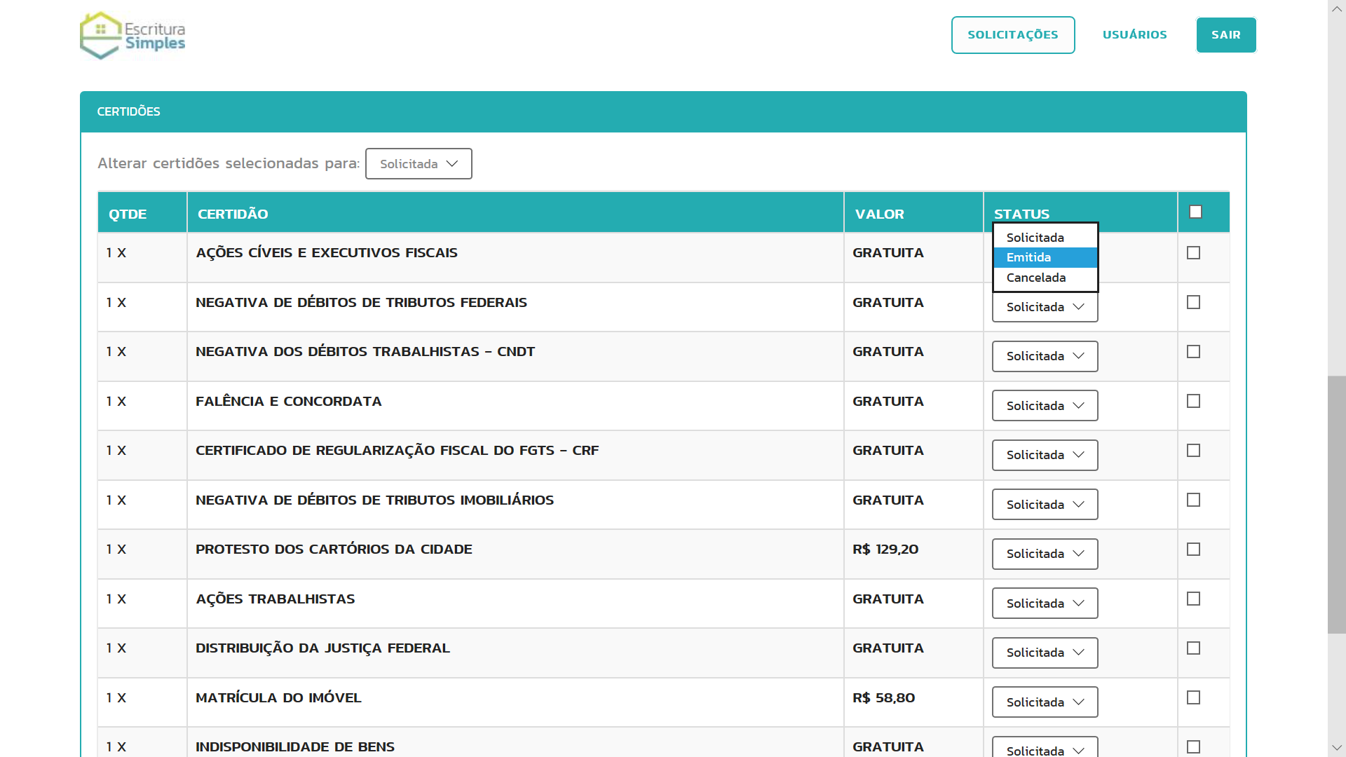
Registering Property
www.escriturasimples.org.br
Update of Request by Notary Office

Slide 27
Registering Property
Questionnaire
Procedure | Description
Procedure 13 | Register the transfer deed (escritura) at the appropriate Real State Registry
Comments:
This procedure is already done on line by the notaries without interaction with the parties.
There are some changes on Real State Registry rules according to Provimento 05/2018 that has reduced time to provide property registration.
Eletronic deeds can be sent on line to the Real State Registry by the notary and are now registered in only 10 days.

Slide 28
Registering Property
Questionnaire
Procedure | Description
Procedure 14 | Update land taxation records at City Hall
Comments:
This procedure should be excluded because Real State Registry is already responsible for automatically updating land taxation records without any interaction with the parties.

Slide 29
Registering Property
It is INCLUDED in the notary’s job:
To confirm which certificates the buyer wants to request and request all of them ON LINE, AT THE SAME DAY, at no extra cost;
To review all the documents presented by the parties and to draft the deed at the same day;
To pay the transfer tax to the City Hall on internet banking;
To get buyer and seller’s signatures on the deed and to send it ON LINE to real estate registry at the same day.
* There are 13.262 notary offices in 5.570 cities in Brazil.
It is INCLUDED in the real estate registry’s job:
To register the deed received on line in 10 days in order to transfer the ownership of the property from seller to buyer;
To inform the City Hall on line to update the land taxation records.
The only procedure that needs a party interaction is to go to a notary to SIGN the deed. All the others can be made on line.

Slide 30
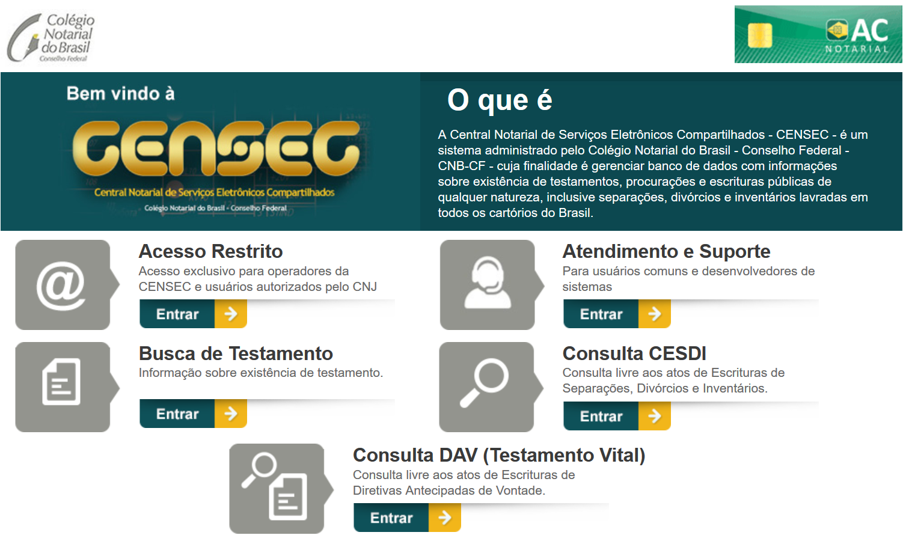
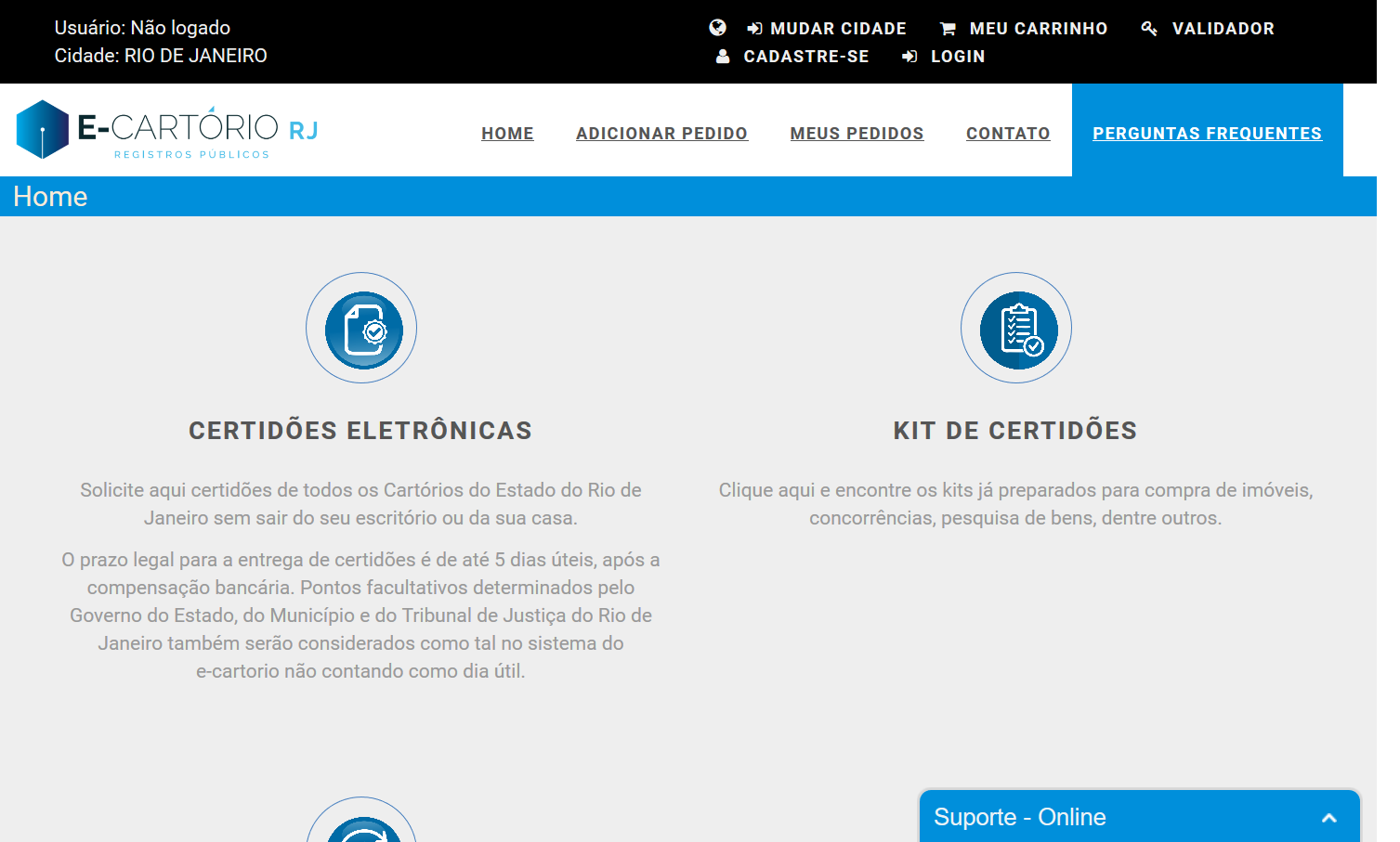
Registering Property
Law 13.465/2017
SREI (ONR)
Reurb
Concrete Slab rights - Direito de laje, condomínio de lotes
Urban Adverse Possession - Usucapião urbana
Portals for requesting certificates
censec.org.br
registradores.org.br
sistema.registrocivil.org.br
e-cartoriorj.com.br

Slide 31
Thank You

