Slide 1

Working for the Right to adequate food at International level
Ana María Suárez Franco
Permanent Representative in Geneva

Slide 2
Where
UN Human Rights System
Commitee on Food Security (Rome Instiitutions: FAO, IFAD, IDLO)

Slide 3
The Framework
The history – Consultative status – The new challenges
The loop of the 8: Cases and public polcies/laws etc. – The processes behind
Standart setting: Changing or creating
Specific recommendations to national authorities
According to FIAN Strategic Plan
Communication to FIAN SCC and Partners

Slide 4
What: Main topics
The Right to Food – A Holistic concept: From access to nutrition
Gender and women rights
Peasants and indigenous Rights (Right to Land/Land grabbing)
Accountability: Monitoring + Justiciability (OP)
Extraterritorial Obligations of States:Including Non-State actors

Slide 5
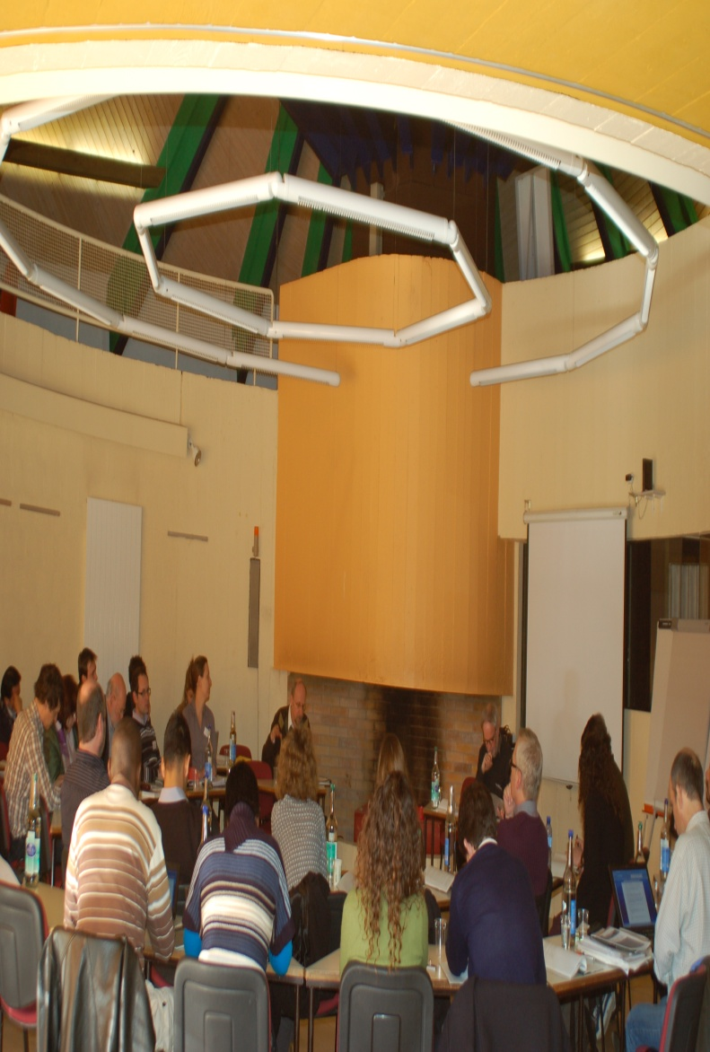
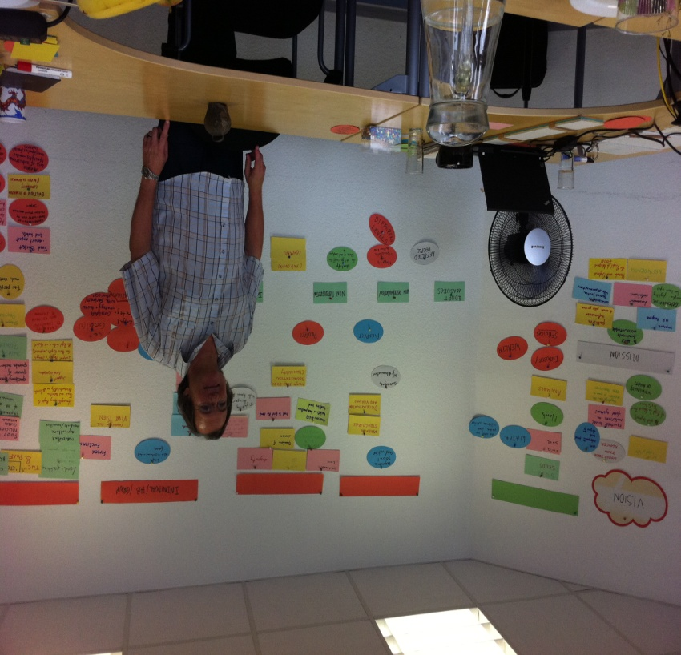
The Process & The Team

Slide 6
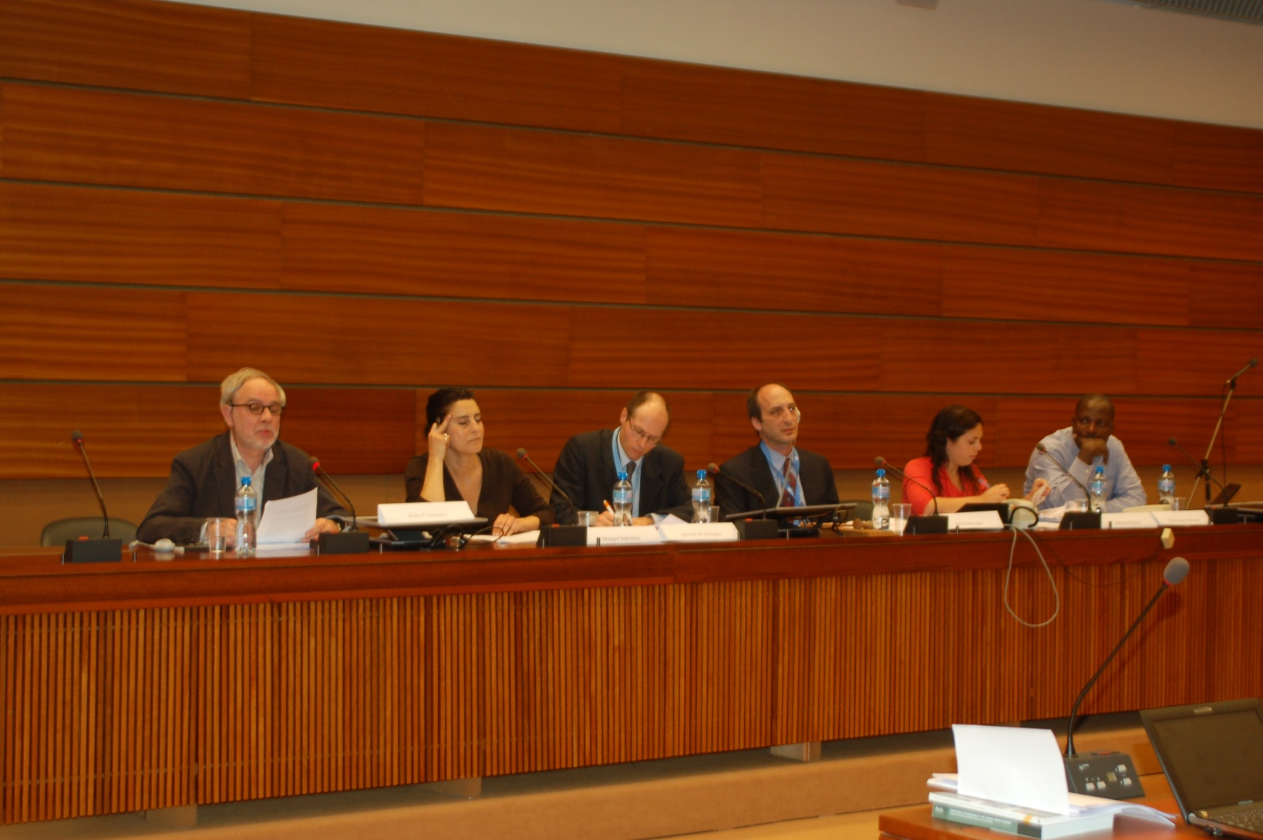
At the UN Human Rights System

Slide 7
Which bodies
Treaty Bodies: ESCR, CEDAW, CRC
Office of the high Comissioner for Human Rights
Human Rights Council - Special Procedures -Advisory Committee
CFS – Rome Institutions

Slide 8
How to lobby?
Bilateral interviews and talks
Facilitation of CS participation in diverse fora
Submissions to consultations/standart setting and inputs to negociations
Paralell reports
Written and oral statements
Lunch briefings & side events
Communications to Special Procedures
Civil Society Meetings - procesess

Slide 9
Treaty Bodies: CESCR, CEDAW, CRC
Composition: Independent Experts
Mandate: Interpretation of the covenants trough General Recommendations or General Comments / Statements
Monitoring implementation of States human rights obligations under a specific treaty: Concluding Observations – Standart setting
Communications Procedures: Complaint mechanisms for individuals

Slide 10
Committee on Economic Social and Cultural Rights – FIAN‘s work
Alternative Reports:
Importance of reporting process – national process
Phases of the process: National, regional and in Geneva
Alliances and networking
Giving voice to the victims at the UN
Importance of follow up

Slide 11
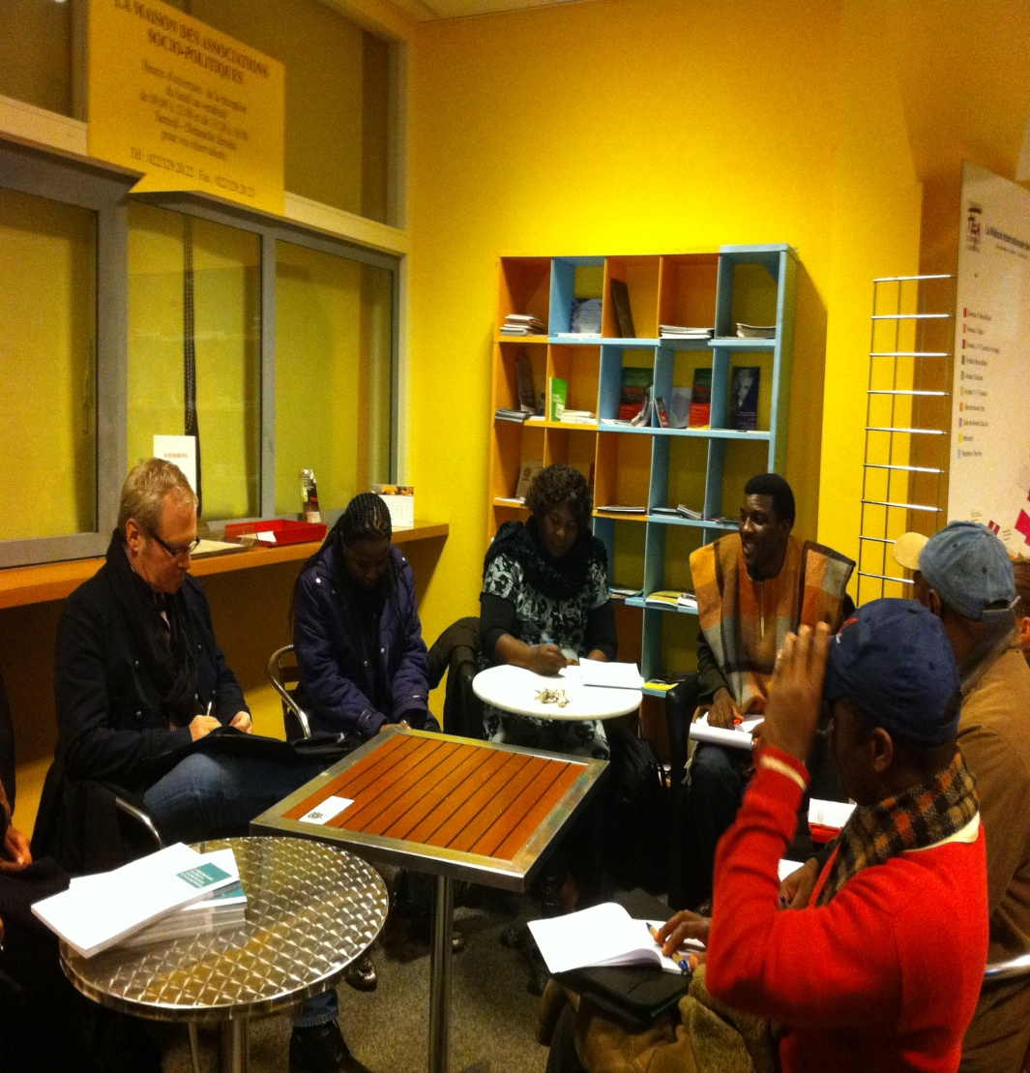
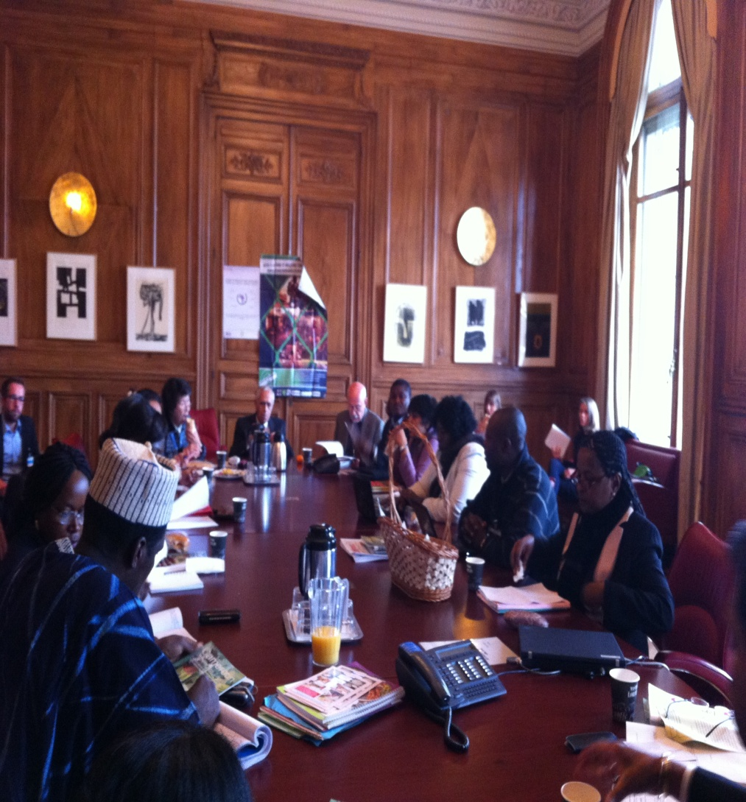
Lunch Briefing Cameroon

Slide 12
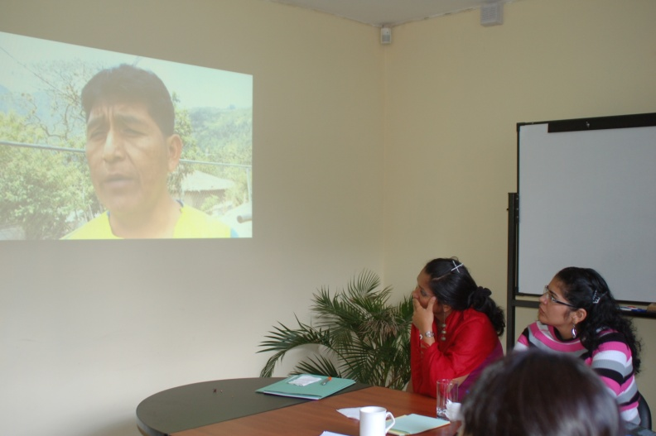
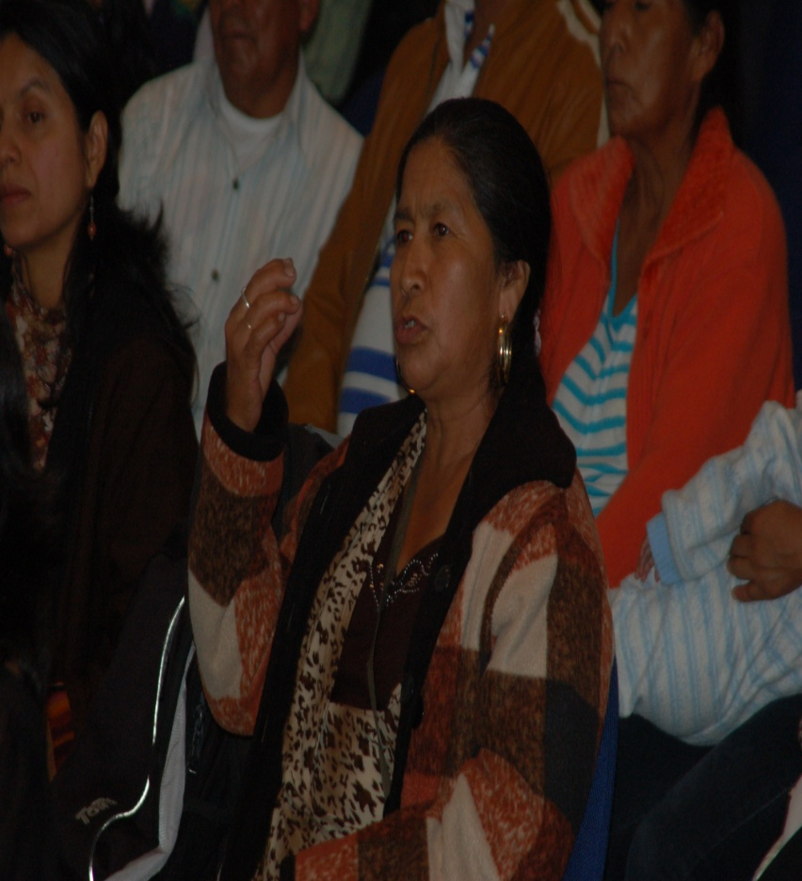
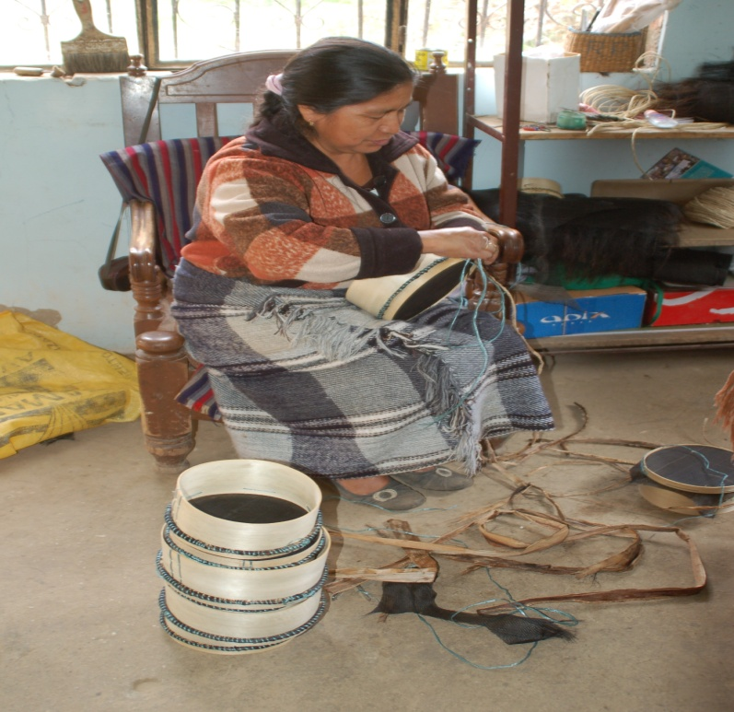
Preparing for Ecuador‘s Report

Slide 13
CESCR
Standard setting:
General Comments 12, 15,
Reporting Guidelines
IBSA
Statements on non state actors and Rio + 20
Rules of Procedure for the Optional Protocol
On going: Tenure guidelines, land grabbing and, peasant rights, extraterritorial obligations

Slide 14
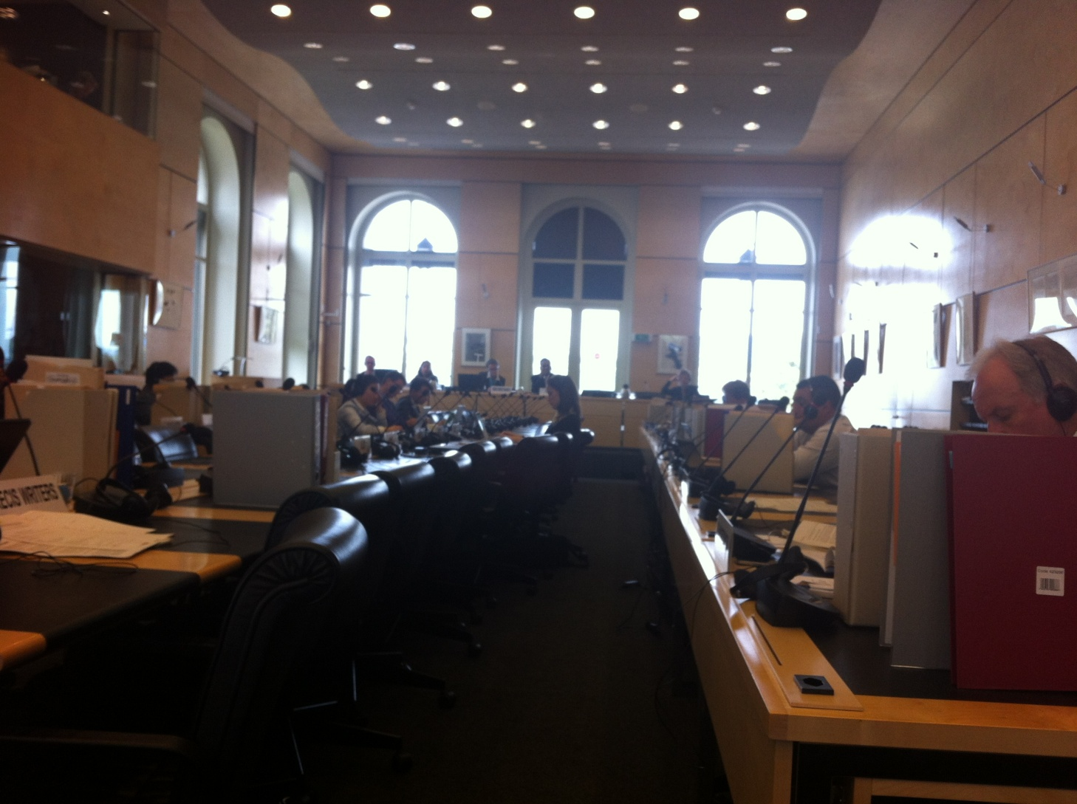
CESCR at Palais Willson

Slide 15

CESCR
The Challenge: The Optional Protocol on ESCR
Human Rights Bodies recommendations for ratification(UPR, ESCRC)
Bringing cases: Strategic litigation on FIAN cases
Working Rules
Committee members Election
Importance of NGO Coalition

Slide 16
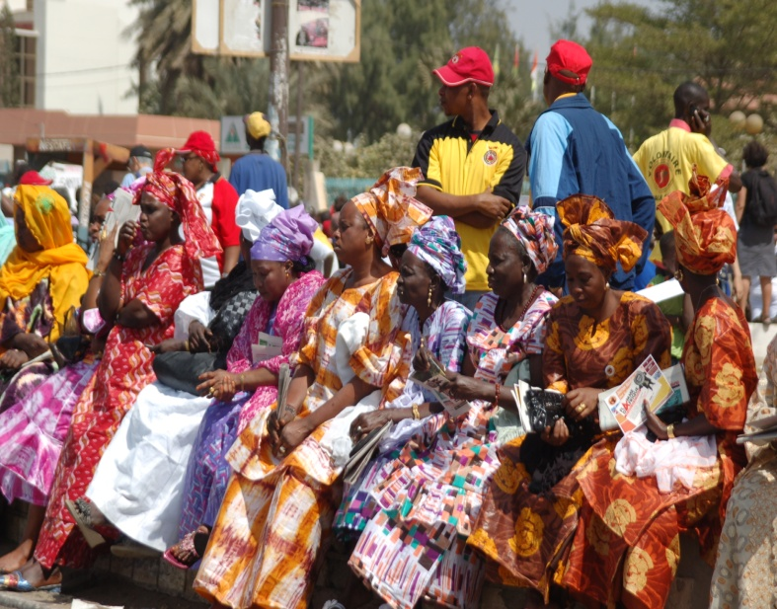
CEDAW – FIAN‘s work
The beginn & the differences
IRAW – Asia Pacific
Regular lunch briefings
First Report: Nepal – Lobby experience
Statements: Paraguay, Mexico, Togo..coming report Austria
Thematic lunch briefings towards a General Recommendation on The Right to Food, Nutrition and Gender
Future General Recommendation on Rural Women, Including the Right to Food
Alliances: UHO and IBFAN/GIFA …PWESCR

Slide 17
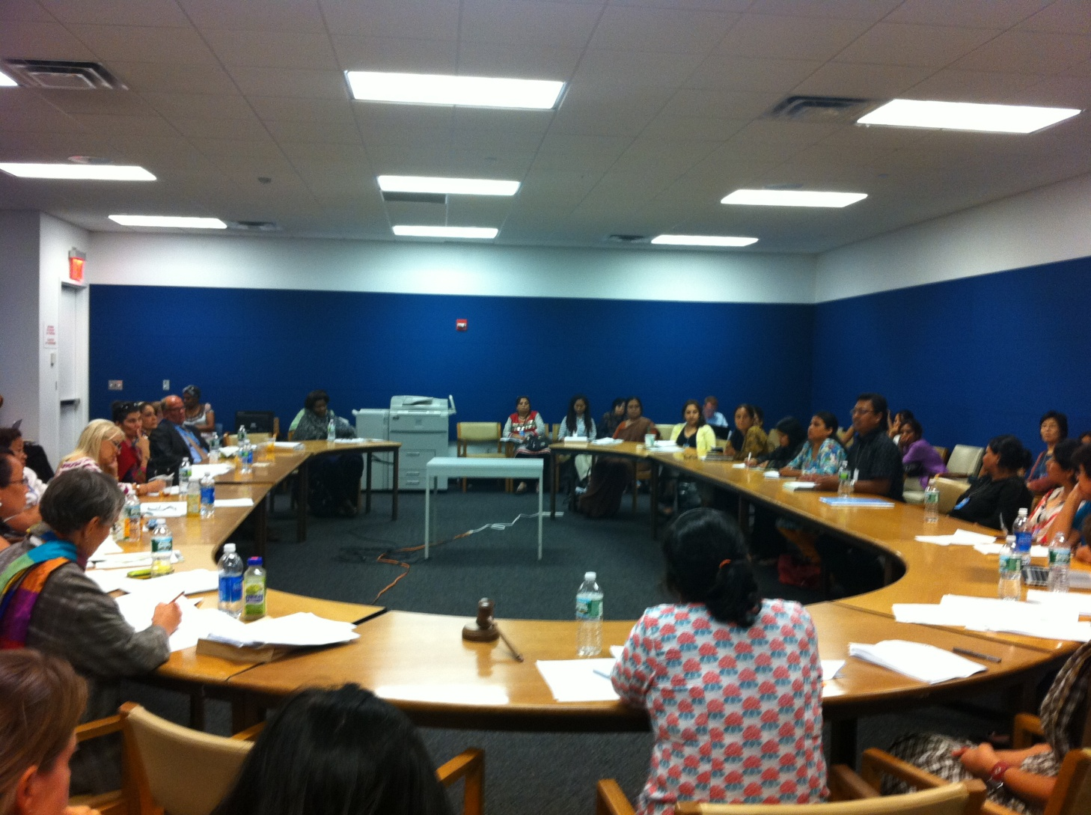
Lunch Briefing on Nepal

Slide 18
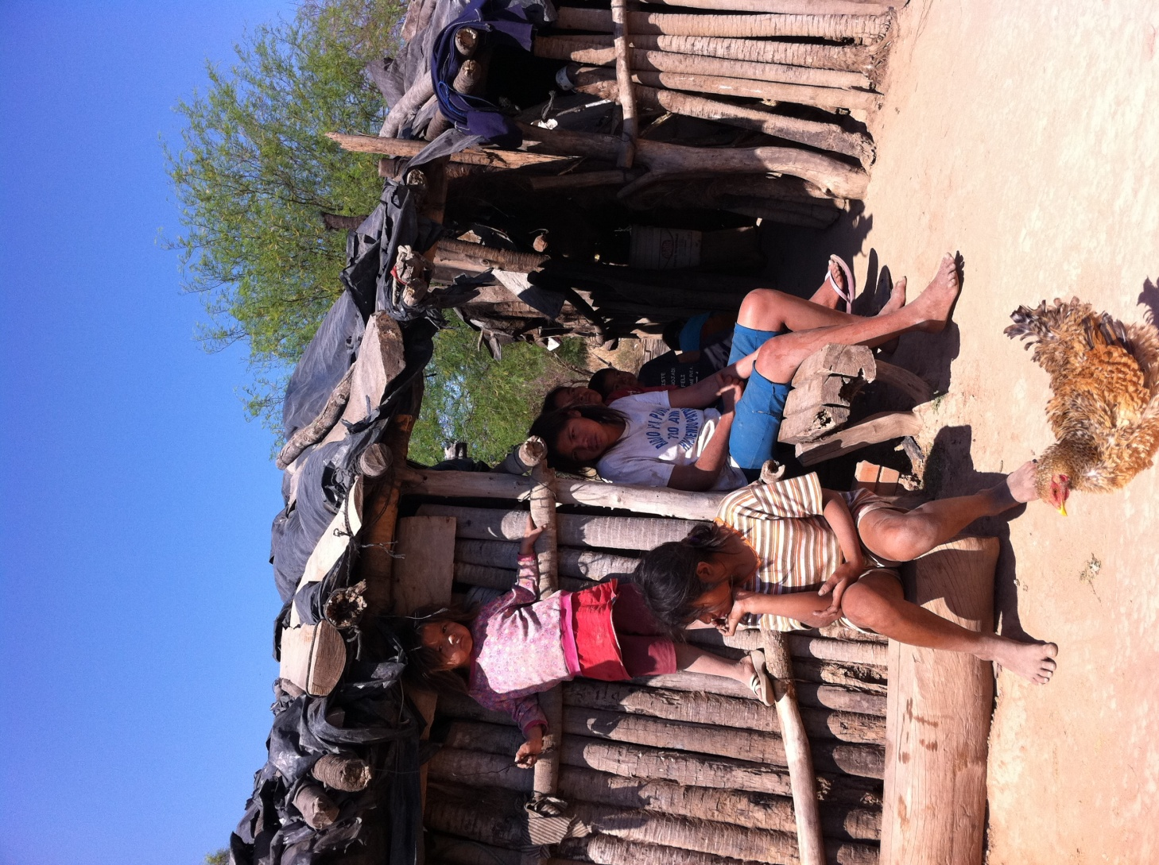
Visit to Paraguay

Slide 19
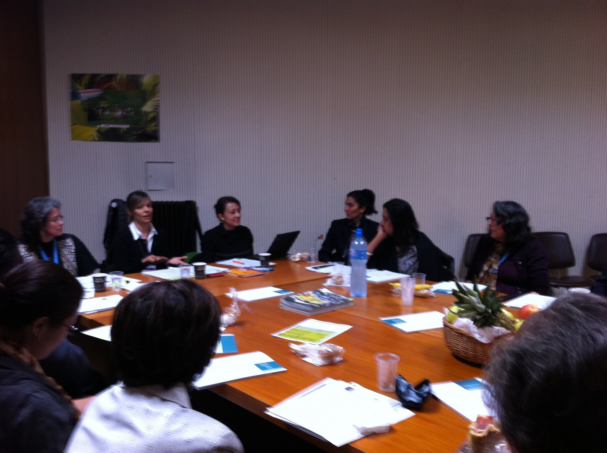
Lunch Briefing Right to Food, Nutrition and Gender

Slide 20
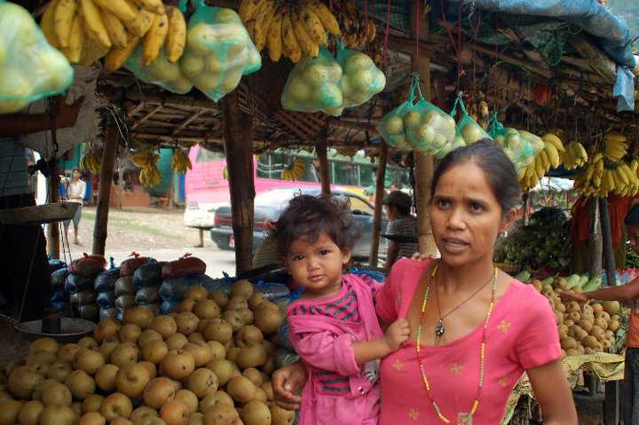
Committe on Child Rights
Forthcoming work
First submission on non state actors, gender and the Right to Food – ETO
Alliances: IBFAN - UHO

Slide 21
Human Rights Council
Tasks:
Protect human rights
Promotion and imlementation of human rights
To develope new concepts and politics
Standard setting at international and national level
To protect and avoid human rights violations
Coordination of human rights work at UN
Follow up and implementation

Slide 22
Human Rights Council
Structure
47 States
13 Asia
13 Africa
8 Latin- America
7 West Europe and others
3 years periods prolongable once

Slide 23
Human Rights Council
Instruments
Univeral Periodic Review: peer review
Special procedures
Individual persons or groups
Expertise
Report to HRC and eventually GA on topic or country (1 a year)
Complaint procedures
Identification of systematic violations by a state (individuals are not the plantifs)

Slide 24
Human Rights Council – FIAN‘s work
Human Rights Council Ordinary Sessions
Written statements
Oral Statements
Side Events
Opening space for national CSO and communities
Lobby work
Universal Periodic Review
Written submissions
Bilateral lobby

Slide 25
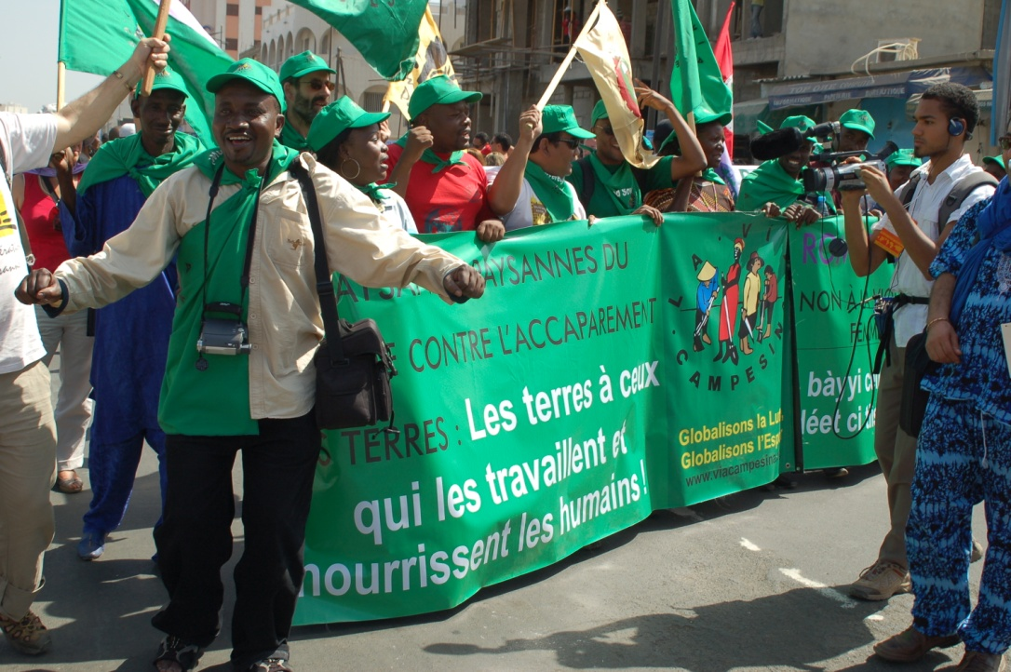
Some examples
Food Crisis 2008
Optional Protocol to CESCR
Rights of people living in rural areas
Tenure Guidelines – Conecting with Rome
New Openended working roup

Slide 26
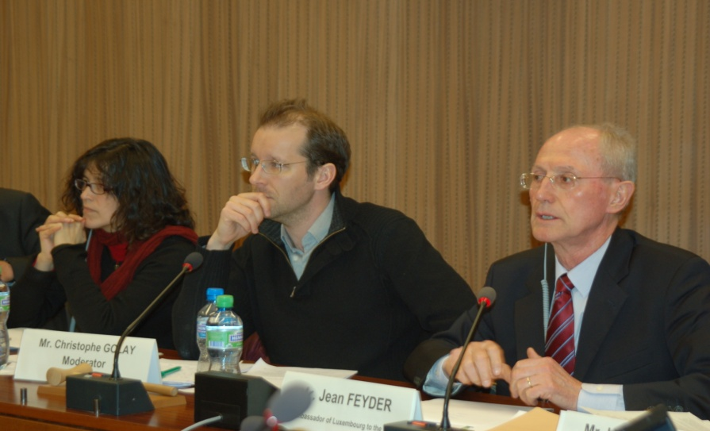
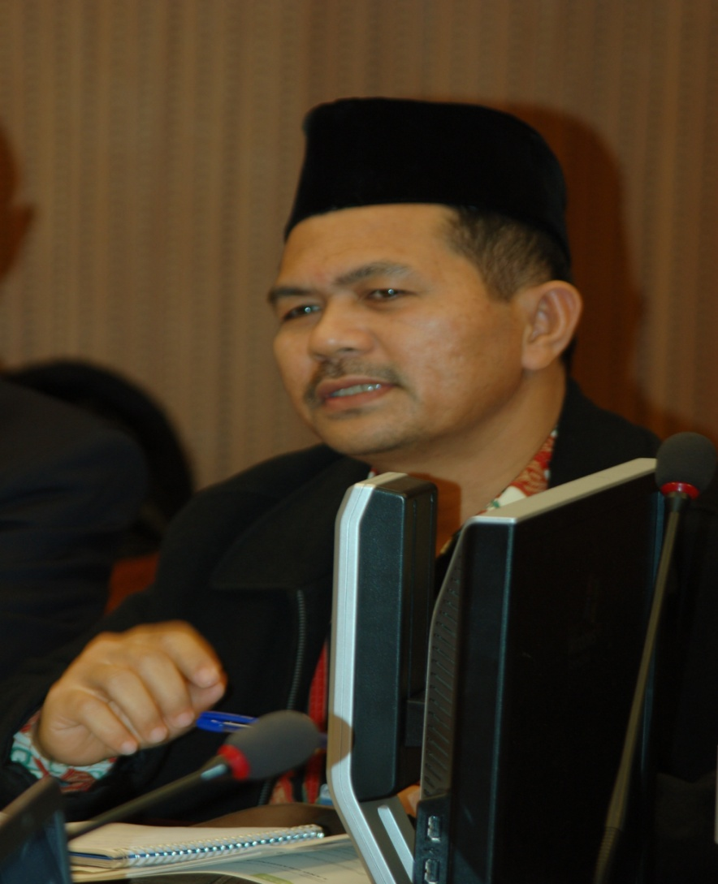
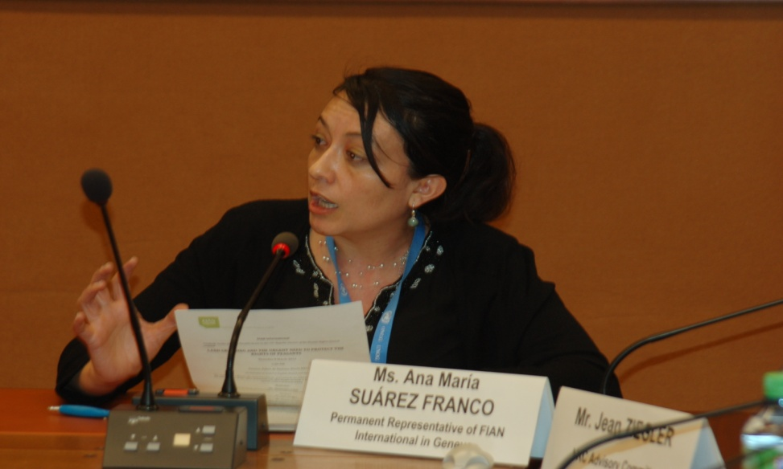
Working with La Vía Campesina at HRC – Declaration on Peasants Rights

Slide 27
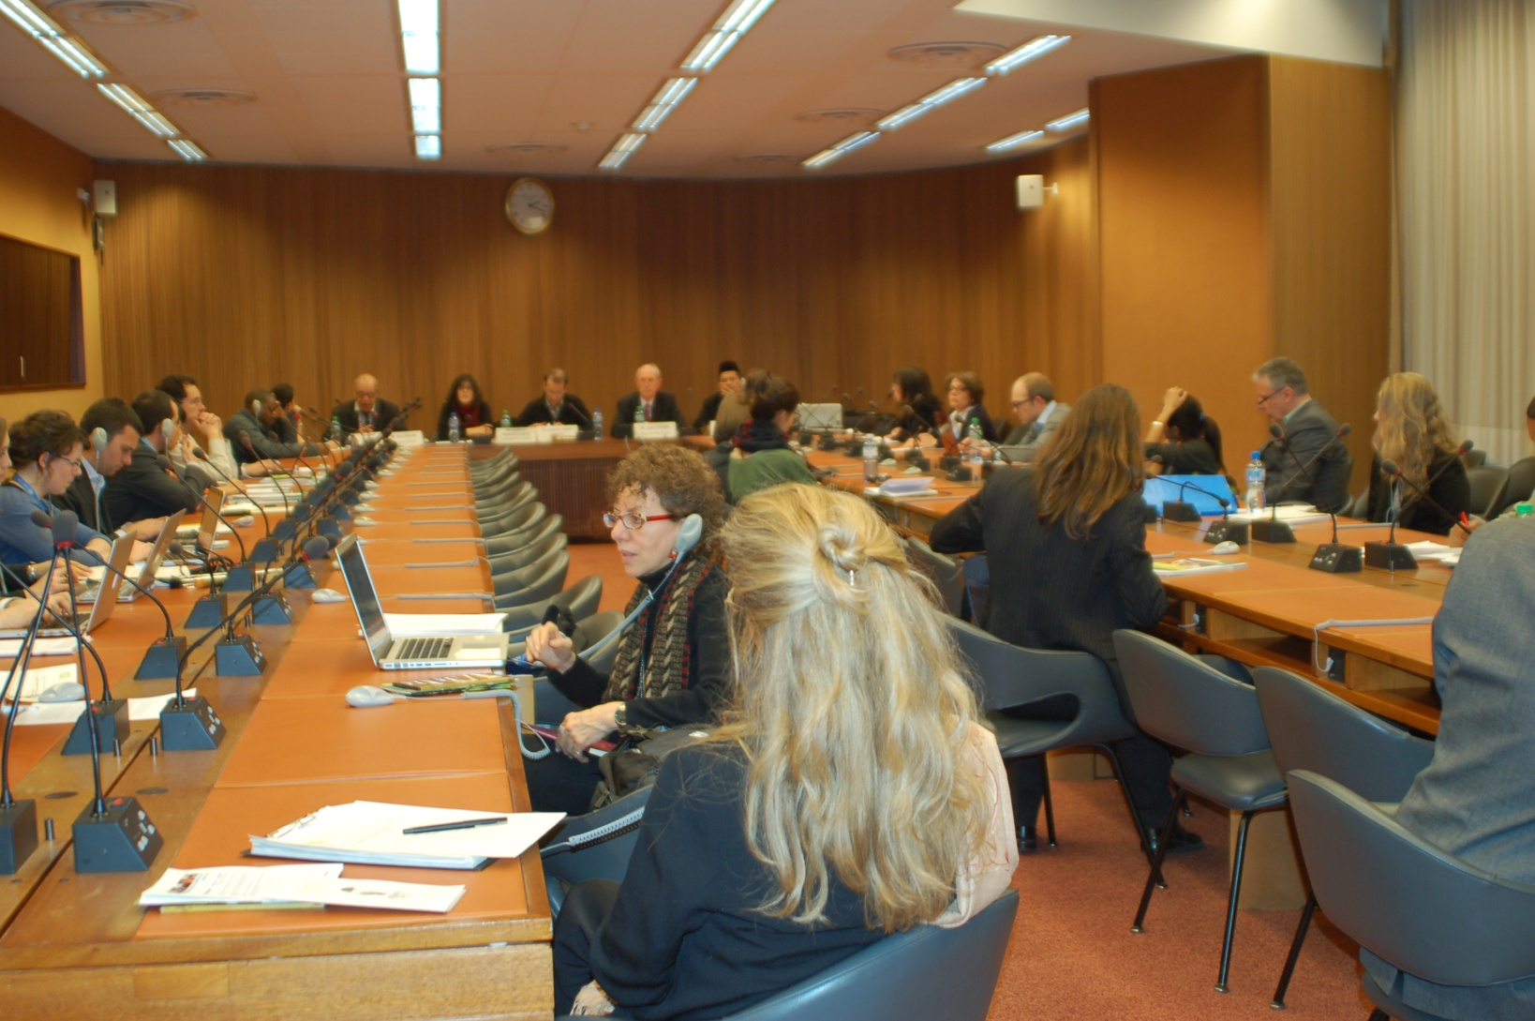
Side Event on Peasants Rights

Slide 28
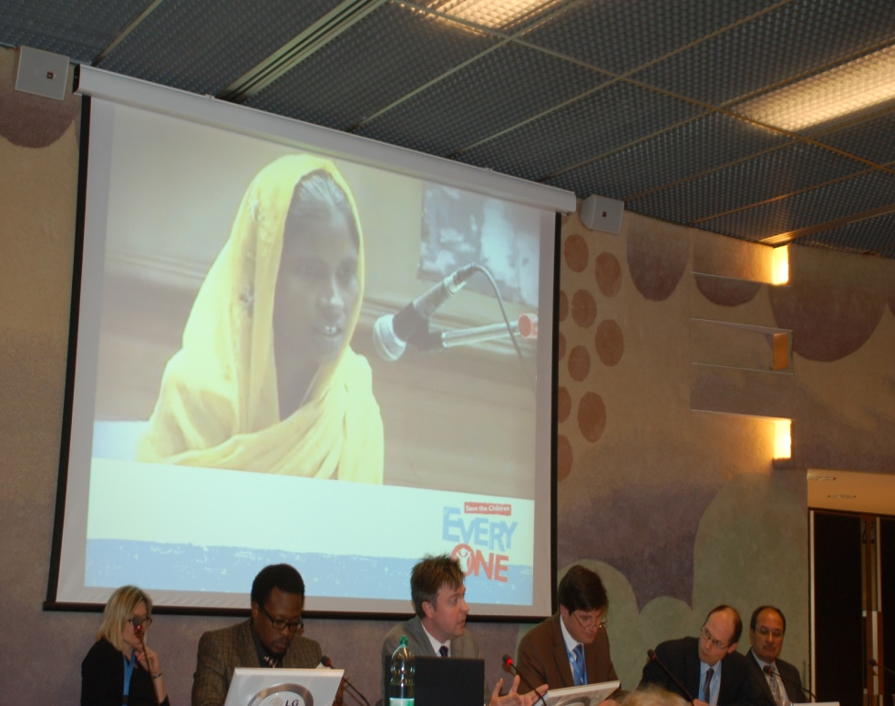
Special Procedures – FIAN‘s work
Special Rapporteur on the Right to Food
Bilateral talks
Communications
Preparation of mission
Inputs for thematic reports
Invitation to FIAN events
Work with the team

Slide 29
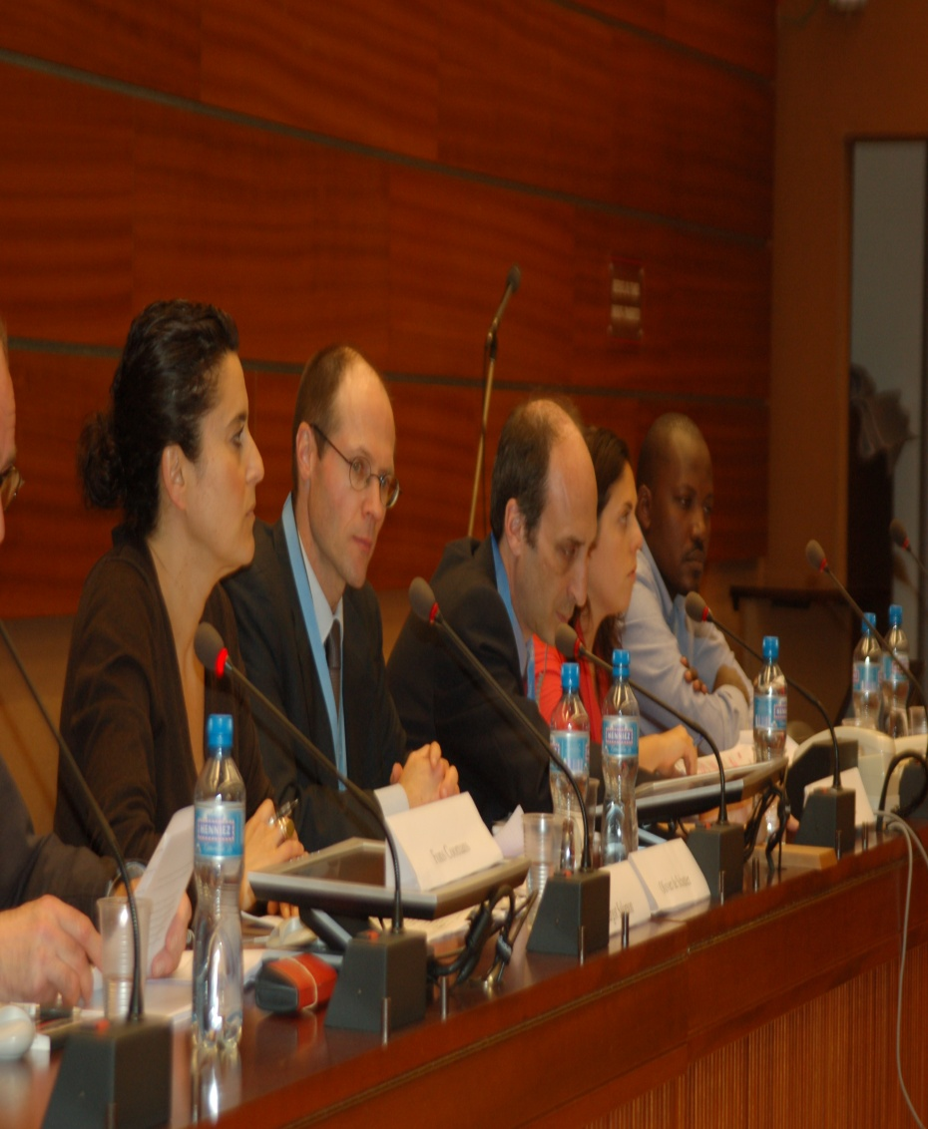
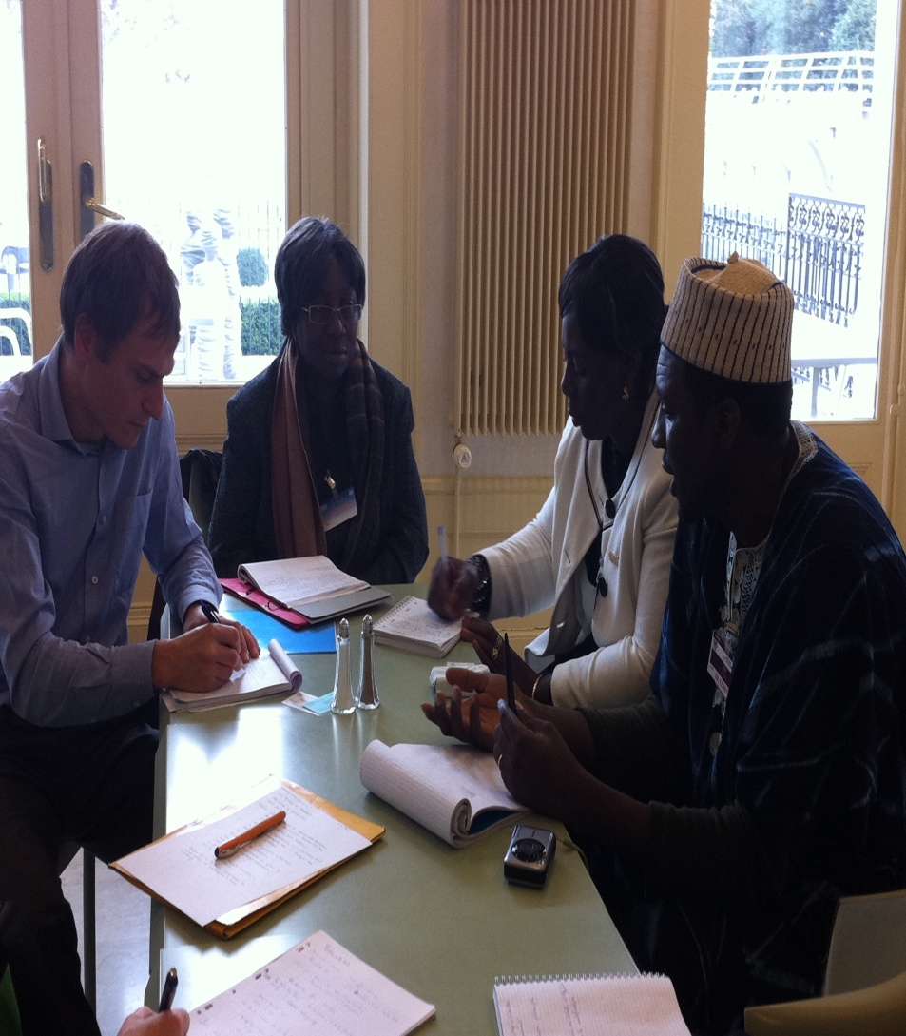
SR Right to Food Team

Slide 30
Other Special Procedures
SR Extream Poverty and Human Rights
SR Human Rights Defenders
SR Indigenous Peoples
SR on Solidarity
HRC Working Group on Discrimination against Women in Law and Practice
New SR on Peasant Rights?

Slide 31
Office of the High Comissioner
Mandate
To promote and protect the enjoyment and full realization, by all people, of all rights established in the Charter of the United Nations and in international human rights laws and treaties.
Structure
Diverse offices and divisions coordinating the HRC. Example: Treaty Body secretariats, petitions unit, division on ESCR, country desks, civil society division.

Slide 32
OHCHR – FIAN‘s work
Division on ESCR
Responsible person for the Right to Food
SR Team
Country officers
Civil Society
Officers on thematic issues: Petitions Unit

Slide 33
FIAN‘ work in Rome
World Food Summit 1996: Objective to clarify and guide national implementation of the RtAF
- Development of the General Comment 12, issued by the CESCR in 1999
- Negotiation of the Right to Food Guidelines, 2002-2004, appoved by the FAO Council 2004

Slide 34

Committee on Food Security
Multi-stakeholders body
Food Governance: deciding on concrete actions to address issues affecting food security and nutrition
Members: FAO, IFAD, WFP. Other UN state members than FAO members
Paticipants: representatives of UN agencies and bodies, civil society and non-governmental organizations and their networks, international agricultural research systems, IFIs and representatives of private sector associations and private philanthropic foundations

Slide 35
FIAN‘ work in Rome
Reform of the CFS in 2009, since then:
FIAN facilitated, with the Working Group of the IPC, and within the context of the Civil Society Mechanism the civil society input to the elaboration and negotiation of the new Voluntary Guidelines on Responsible Governance of teneure of Land, Forest and fisheries, (2009-2012, adopted in May 2012 by the CFS.

Slide 36
FIAN‘ work in Rome
FIAN co-facilitated with Vía Campesina the CSM Working Group on the Global Strategic Framework for Food Security and Nutrition (GSF) organizing the civil society input to the elaboration and negotiation of the GSF (2010 to 2012, adopted in October 2012 by the CFS.
Natalia Landívar, FIAN Ecuador, participates as member of the CSM Coordination Committee, since 2011.

Slide 37
And more in Rome
Work on the Right to Food with diverse divisions as former Right to Food Unit and Legal Division: Developement of materials, capacity building initiatives, inputs to framework law procesess
New steps towards a project to improve right to food justiciability with IDLO

Slide 38
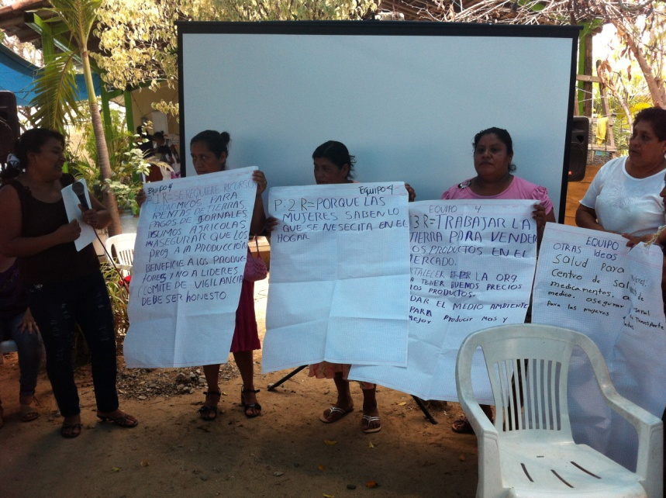
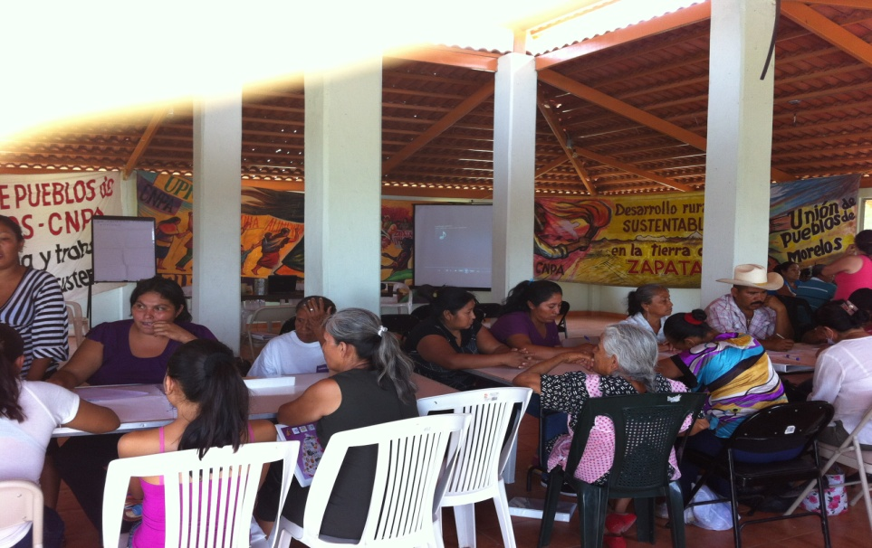
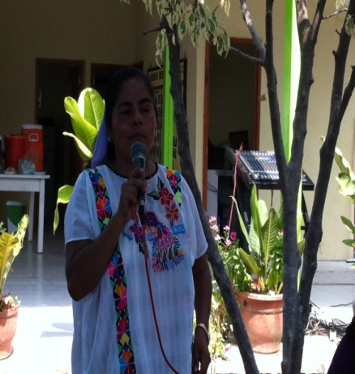
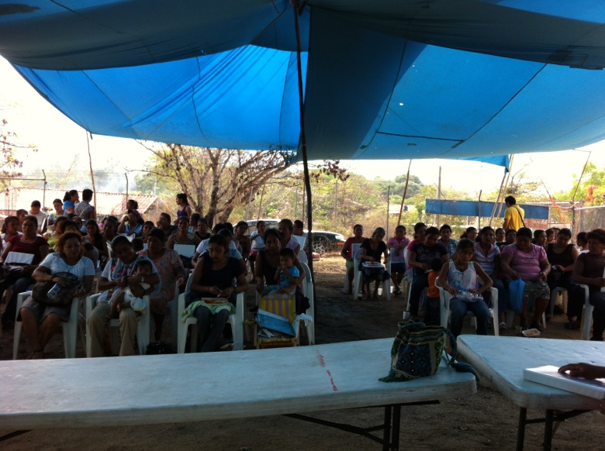
Gracias !!!!!
Suarez-franco@fian.org

